Slide 1
EndNote 20
EndNote 20, the world’s essential reference management tool, helps you save time, stay organized, collaborate with colleagues, and ultimately, get published. So, you can focus on what matters most: your ideas.

Slide 2
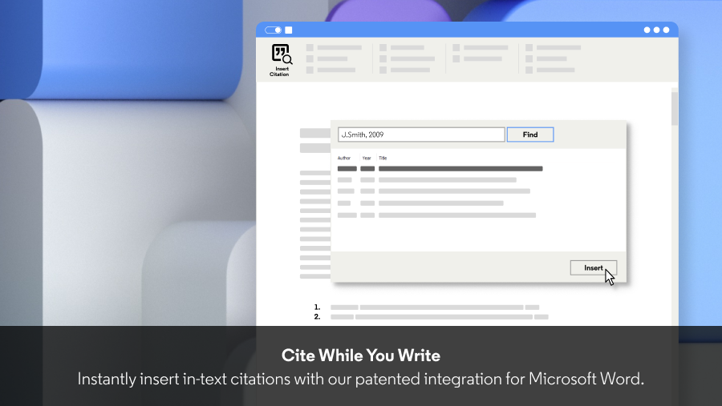
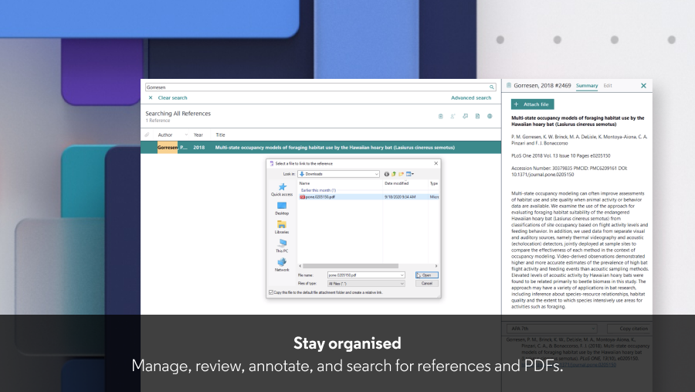
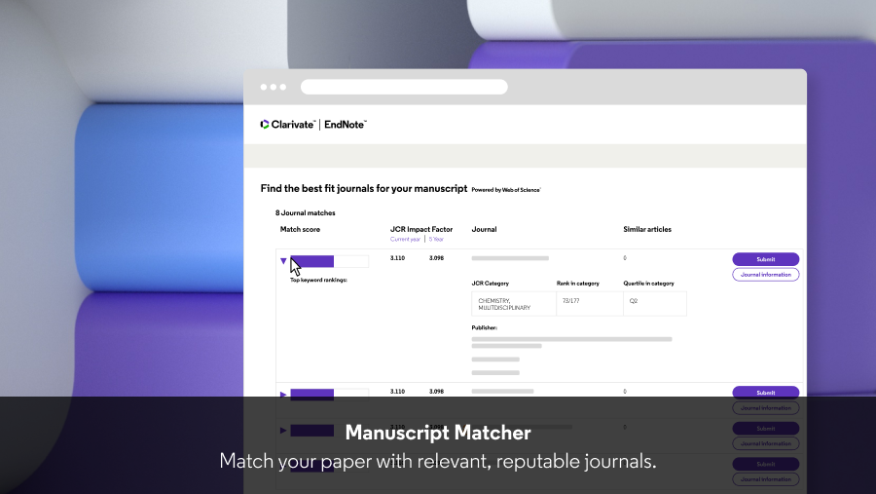
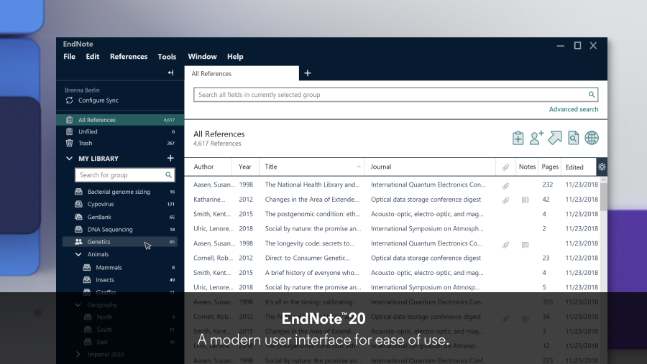
1
2
3
4
5

Slide 3
Accelerate your research
Search hundreds of online resources for references and PDFs.
Access full text research articles with one click.
Easily read, review, annotate and search PDFs in your library.
Create rules to automatically organize references as you.
Keep your data accurate with automatic reference and link updating.
Quickly deduplicate the content in your library by searching on unique identifiers.
Insert in-text citations from your library with the Cite While You Write feature in Microsoft® Word.
Automatically build your bibliography using the library of 7,000+ reference types or your own customized style.
Ensure your bibliography is accurate with refreshed journal and referencing styles.
Access your research anytime, anywhere from the cloud. Move seamlessly between online and the desktop and iPad applications.
Share some or all of your library with collaborators worldwide.
Provide write or read-only access to your library.
Use the new Tabs feature for easier multitasking.
Track your teammates’ changes and view their activity in your shared library.
Match your paper with relevant, reputable journals using Manuscript Matcher.
Conduct large-scale literature reviews with ease and speed using the powerful analysis tools.

Slide 4
New Features
All the power and flexibility you love, modernized for ease of use.
New interface design Save even more time preparing manuscripts and managing bibliographies with an intuitive user interface. Cite While You Write Insert in-text citations while creating a bibliography in Microsoft® Word. 7,000+ reference styles Build your bibliography in any included style, or customize your own style. Improved reading & editing Read and annotate more easily with full-size PDFs, and quickly copy a formatted reference. Share & collaborate Share selected groups of references, manage team access and track activity and changes.

Slide 5
EndNote 20 for Windows
As part of your existing EndNote site license, you can now upgrade to EndNote 20 for free. The Windows installer is now available.
You can download your institution's dedicated Windows installer below:
https://download.endnote.com/downloads/20/EN20Inst.msi

Slide 6
EndNote 20 for macOS
As part of your existing EndNote site license, you can now upgrade to EndNote 20 for free.
You can download your institution's dedicated macOS installer below:
http://download.endnote.com/site/32e7f7363bfd11eb8c37cd493918a07e/EndNote20SiteInstaller.dmg

